Slide 1
English Stylistics
Week 8
Metric patterns in English poetry

Slide 2
A Quick review: Rhymes
Alliteration (CVC) – great/ grow
Assonance (CVC) – send/ bell
Consonance (CVC) – send/ hand
Reverse rhyme (CVC) – great/ graze
Pararhyme (CVC) – send/ sound
Rhyme (CVC) – send/ mend

Slide 3
In-class exercise: rhymes in English
Row, row, row a boat.
It takes two to tango.
This is a hit-or-miss solution.
Publish or perish.
Time and tide wait for no man.
Life for me ain’t been no crystal stair.

Slide 4
Exercise
row – boat assonance
take-two-tango alliteration
hit-or-miss assonance
publish or perish pararhyme
time – tide reverse rhyme
crystal – stair consonance

Slide 5
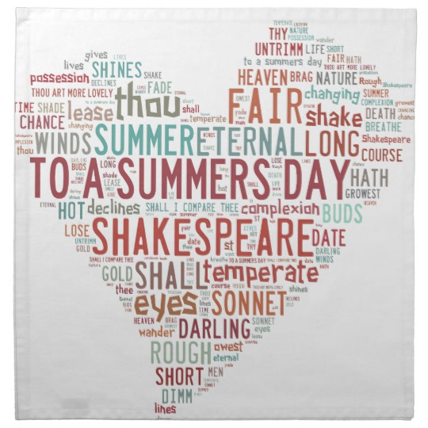
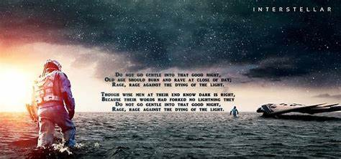
Assignment

Slide 6
In today’s class
Stressed and unstressed syllables
Poetic metrics: Foot and meter （音步与韵律）

Slide 7
The metrics of English poetry
Poet: The pace and breathing of poetry
Reader: Focused attention & feeling
The measurement: Syllables → Foot → Meter

Slide 8


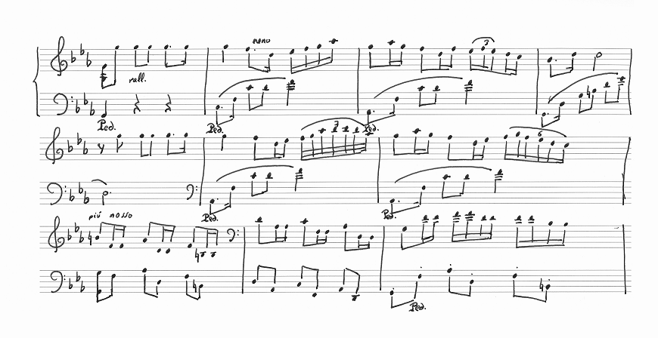
Syllables: strong vs. weak beats
To swell the gourd and plump the hazel shells.

Slide 9
Stressed vs. unstressed syllables
Stressed (−) vs. unstressed (∪)
enOUgh
∪ −
hAndful
− ∪
elEven
∪ − ∪

Slide 10
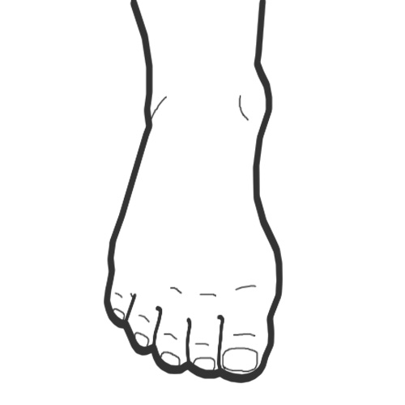
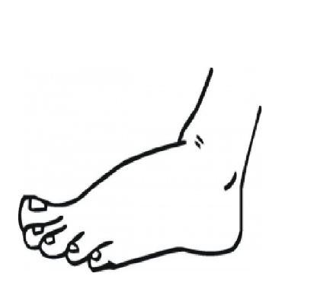
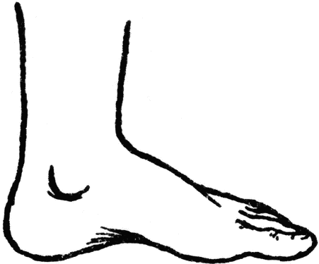
Foot 音步
The recurring unit of rhythm
A sequence of syllables (not words)
At least one stressed syllable
[− ∪] or [∪ − ] or [∪ ∪ −] …

Slide 11
Poetic foot types
[∪ −] → Iambic foot “away” “at once”
[− ∪] → Trochaic foot “only” “hope so”
[∪ ∪ −] → Anapestic foot “intervene”
[− ∪ ∪] → Dactylic foot “happily”

Slide 12
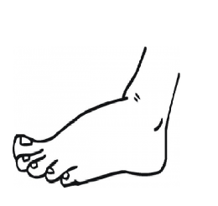
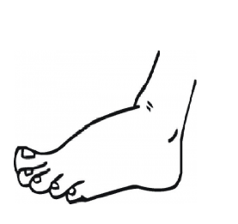
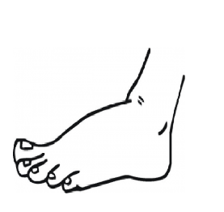

Meter 格律
An sequence of the recurring foot in a line
The regular/ predominant pattern
[A mile] [ to go] [before] [I sleep ]
[∪ −] [∪ −] [∪ −] [∪ −]

Slide 13


Meters (number of feet in a line)
Dimeter
Trimeter
Tetrameter
Pentameter
Hexameter
Heptameter
Octameter …

Slide 14
Foot and meter: Example 1
To strive, to seek, to find and not to yield.
[∪ − ] [ ∪ − ] [ ∪ − ][ ∪ −] [ ∪ −]
→ iambic pentameter

Slide 15
Foot and Meter: Example 2
And the sheen of their spear was like stars on the sea.
[∪ ∪ − ] [ ∪ ∪ −] [ ∪ ∪ −] [ ∪ ∪ −]
→ anapestic tetrameter

Slide 16
In-class exercise: Handout
Identify the foot and meter of the poetic lines.

Slide 17
Iambic pentameter
So long as man can breathe and eyes can see,
So long lives this, and this gives life to thee.
Heroic couplet

Slide 18
Trochaic tetrameter
Tiger! Tiger! Burning bright
In the forests of the night…
The Tiger by William Blake (1757-1827)
Starting with a stress → assertive

Slide 19
Dactylic tetrameter
We that had loved him so, followed him, honored him,
Lived in his mild and magnificent eye…
The Lost Leader by Robert Browning (1812-1883)
A feeling of decline, sadness, and falling away from certainty.

Slide 20
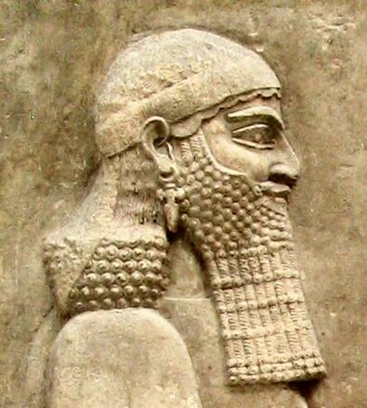
Anapestic tetrameter
The Assyrian came down like the wolf on the fold,
And his cohorts were gleaming in purple and gold
(Byron, The Destruction of Sennacherib, 1788-1824)
Emotional tension, Horse galloping

Slide 21
Blank verse and free verse
Blank verse → unrhymed lines in iambic pentameter
→ 素体诗、无韵诗
Free verse → the rhythmic pattern is not organized into metrical feet. (irregular line length, no end rhyme, etc.) → 自由诗

Slide 22
Blank verse in poetry
The world was all before them, where to choose
Their place of rest, and providence their guide:
They hand in hand with wand'ring steps and slow,
Through Eden took their solitary way.
(Paradise Lost, by John Milton, 1608-1674)

Slide 23
Blank verse in poetry
"Frost at Midnight" (1798) by Samuel Taylor Coleridge,
"Hyperion" (1820) by John Keats
"The Second Coming" (1919) by W.B. Yeats.

Slide 24
Blank verse in disguise (from Hamlet)
To be, or not to be: that is the question:
Whether 'tis nobler in the mind to suffer
The slings and arrows of outrageous fortune,
Or to take arms against a sea of troubles,
And by opposing end them? To die: to sleep...

Slide 25
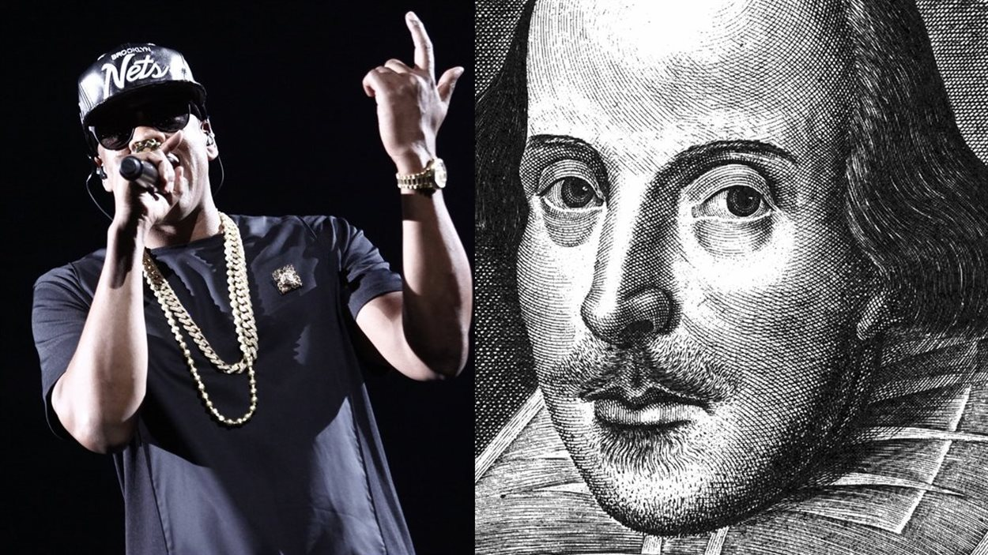
Iambic rhythms in hip pop
The Hip-hop Shakespeare Company (THSC, 2009)
Jay-Z quoting William Wordsworth and Shakespeare

Slide 26
Assignment
Write two different pieces of heroic couplets
(1) A rhymed pair of sentences
(2) iambic pentameter
Bring your works to the classroom next time.

Slide 27
Heroic couplet
For light at dawn I seek with all my might,
Precisely using dark eyes dyed by night.
(by Huilin)

Slide 28
Heroic couplet
If thou to me the Heaven’s wine to toast,
For this an upmost banquet I shall host.
(by Kexin)

